Slide 1


CM 220 Unit 8
Writing an Argument for Change
College Composition II
School of General Education

Slide 2

General Information: LATE POLICY
Late assignments can be marked down one letter grade for each unit the assignment is late.
Assignments submitted more than two units late will not be accepted.
Extenuating Circumstances:
General computer-related or Internet connectivity issues are not considered extenuating circumstances. As the 2010-2011 University catalog notes, “To be part of University’s online program, students will need an Internet service provider (ISP)” (2011, p. 22). It is your responsibility to locate a reliable Internet connection and computer.
Purdue University Global | This is Where the Title of the Presentation Will Go

Slide 3
Late Policy Reminder:
deadlines for Units 8, 9, and 10
Late work from Units 8 and 9 is due the Sunday of Unit 10 (no exceptions unless an incomplete has been granted).
The unit 10 discussion (only main post, no responses to classmates required) is also due the Sunday of Unit 10, per Purdue Global’s late policy:
  You are expected to submit all assignments and projects by the end of the Unit, with the exception of Unit 10 dropbox submitted work and discussion boards. If a dropbox submission or discussion board assignment is due in Unit 10 it will be due at 11:59 ET on Sunday.
  All late work must be submitted by Sunday of the last unit. No late work will be accepted after this without an Incomplete Grade approval.
Purdue University Global | This is Where the Title of the Presentation Will Go

Slide 4
Unit 8 Seminar Objectives
Cover requirements for Unit 8 Assignment
Examine strategies for writing effective introductions and conclusions
Discuss editing and revision strategies.
Purdue University Global | This is Where the Title of the Presentation Will Go

Slide 5
Unit 8
Outcomes and Assignments

Slide 6
Unit 8 “To Do”
To Do | Where to find | Points
Complete Learning Activities | Click on the “Learning Activities” icon
Complete Reading | Click on “Reading” under left navigation bar
Attend live seminar or complete option 2 assignment | Click on seminar icon in Unit 8 | 10
Participate in discussion | Click on “discussion” link under Unit 8 on the left toolbar | 45
Complete Assignment | Click on the “assignment” icon | 175
Purdue University Global | This is Where the Title of the Presentation Will Go

Slide 7
Unit 8 Outcomes
After completing this unit, you should be able to:
Learn what makes an effective body paragraph.
Review the key parts of an essay (introduction, conclusion, topic sentences, body paragraphs, and transitions).
Apply introduction and conclusion techniques.
Apply revision techniques.
Apply editing techniques.
Evaluate effectiveness of a body paragraph.
Course Outcomes practiced in this unit:
CM220-4: Synthesize research and data into a written argument.
GEL-1.02: Demonstrate college-level communication through the composition of original materials in Standard English.
Purdue University Global | This is Where the Title of the Presentation Will Go

Slide 8
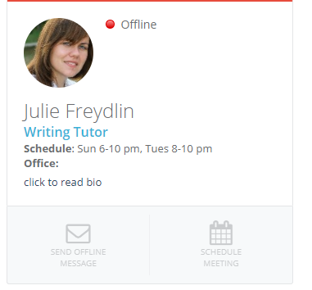
Writing Center tutoring hours
Join us in our new Cranium Cafe Live Tutoring room.
Please use Chrome or Firefox.
Live Tutoring is open Monday 6-10 pm ET; Tuesday 12-10 pm ET; and Wednesday, Thursday, and Sunday 6-10 pm ET. We are closed on University holidays.
Scroll down or click here for a writing tutor. Tutors with green lights on are on duty. Knock on any available tutor's door.
Your first time using Cranium Cafe, you will be prompted to register. Here is a guide to help you: Click here.
Purdue University Global | This is Where the Title of the Presentation Will Go

Slide 9
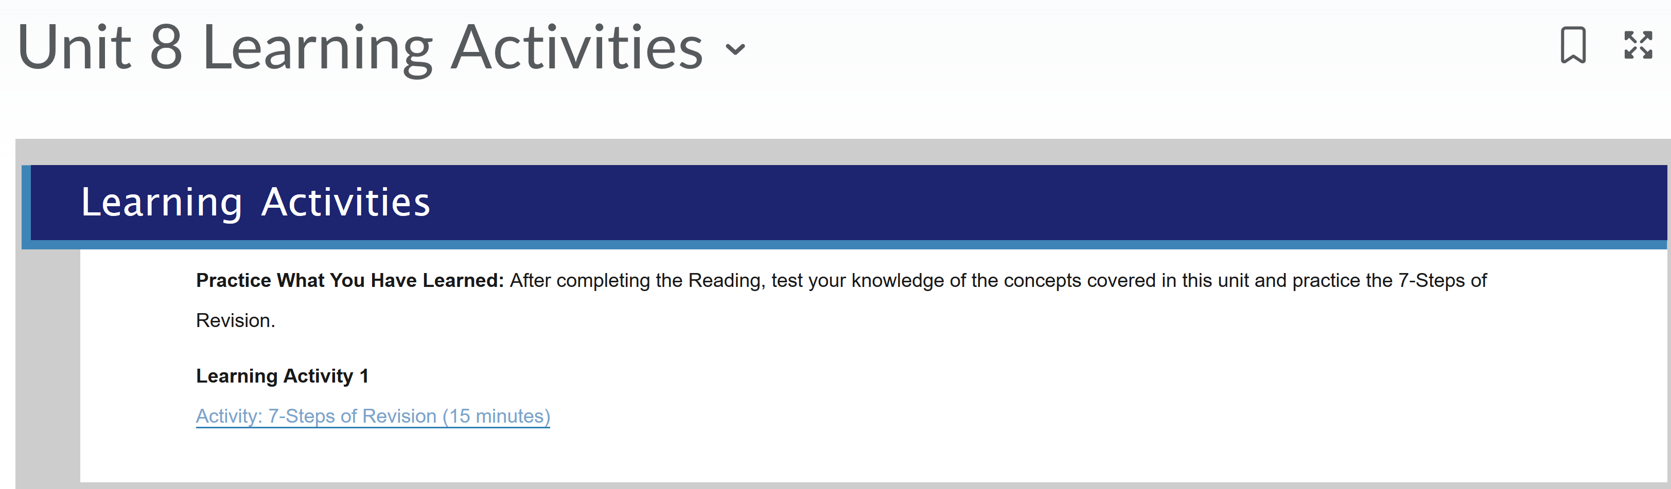
Unit 8 Learning Activities
Purdue University Global | This is Where the Title of the Presentation Will Go

Slide 10
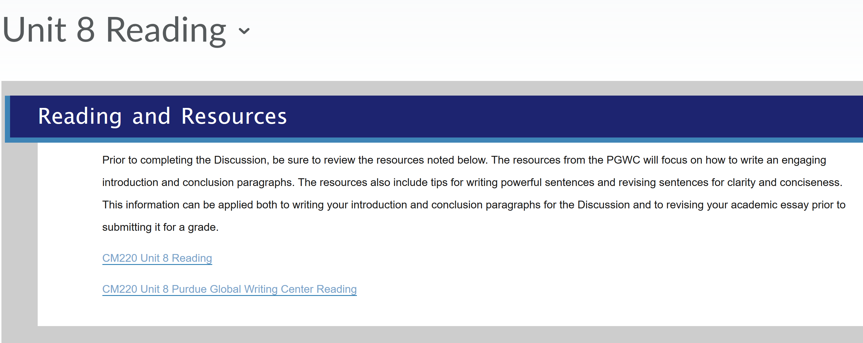
Unit 8 Reading
Purdue University Global | This is Where the Title of the Presentation Will Go

Slide 11
Unit 8 Discussion
Include all of the following in your Discussion post:
A draft of your introduction for your persuasive essay using one of the techniques described in “Crafting Effective Introductions and Conclusions”
A thesis statement as the last sentence of your introduction.
A draft of the first body paragraph for your argument.
Wrap up with an open-ended question about something you need help with, specific feedback you would like to receive, or introductions strategies.
Refer to the Reading and Learnong Activities in your post.

Slide 12
Unit 8 DB Responses
Remember to respond to three classmates’ initial posts. Address the following questions:
Does the introduction end with a persuasive thesis statement? If not, what changes could be made to the thesis statement?
Is the strategy selected for the introduction effective, or might another approach mentioned in the Learning Activities be better?
Identify at least one strength and one area of improvement needed for the introduction paragraph.
Address any lingering questions you have about your classmate’s argument for change.

Slide 13
Expectations for Discussion Post and Responses
Posts:
Submit your post early in the week if you want to receive feedback from the professor and classmates.
The length is at least two well-developed paragraphs.
Refer to Learning Activities in the text and references.
Format in APA 6 ed.
It should be free of spelling, grammar, and punctuation errors.
Review a sample post to be sure your own post meets all the requirements.
Responses:
At least three well-developed responses to different students’ posts.
Each response should be at least one paragraph long.
Posts and responses should be submitted throughout the unit (Wednesday-Tuesday).
Do not submit your post and responses on only one day or on only two days.

Slide 14
Unit 8 Essay: An Argument for Change
Length: 1000 words (does not include the title and references page)
Purpose: Persuasive essay that argues for a change to solve a problem
Includes the following:
  A clear introduction and conclusion.
  A persuasive thesis statement that limits the topic and establishes the essay’s main point.
  References to at least 4 credible sources (at least one book/ebook or periodical article)
  Avoids unreliable sources like Wikipedia and blogs.
Other criteria:
  Combines original thought and relevant support from sources
  Gives appropriate credit to sources, both in-text and on the references page
  Follows APA 6th edition formatting and citation guidelines
  Uses appropriate academic, formal style (stays in third person, avoids slang, etc.)
  Has clear, concise sentences
  Has effective transitions
  Revises any writing integrated from earlier assignments appropriately

Slide 15
Proposal Argument
Introduction:
identifies a problem;
proposes a solution. A persuasive thesis should emphasize the solution angle.
Body paragraphs:
demonstrate that the solution will work (evidence);
establish feasibility (It should be practical; hypothetically, the cost should not outweigh the benefit).
discuss the benefits.
refute opposing viewpoints
Conclusion:
brings the paper to a logical close;
restates the thesis;
recaps the main point of the work

Slide 16
Essay Structure
Introduction:
5-7 sentences
The last sentence is a persuasive thesis statement.
Body paragraphs:
5-7 sentences in each paragraph
Please follow the structure for your body paragraphs: (1) a topic sentence, (2) evidence to support your topic sentence, (3) opposing viewpoints, (4) your refutation, (5) concluding sentence.
Conclusion:
5-6 sentences
The conclusion paragraph should bring the paper to a logical close. Additionally, it should be reflective and recap the main point of the work.

Slide 17
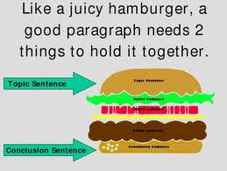
More Help with Paragraphs
Please review the following Learning Activities that will teach you how to create effective body paragraphs:
Effective Writing Podcast Series: Episode 18: “The Four Cs of Effective Writing” (podcast or transcript) and
Effective Writing Podcast Series: Episode 17: “Paragraph Development with PIE.”

Slide 18
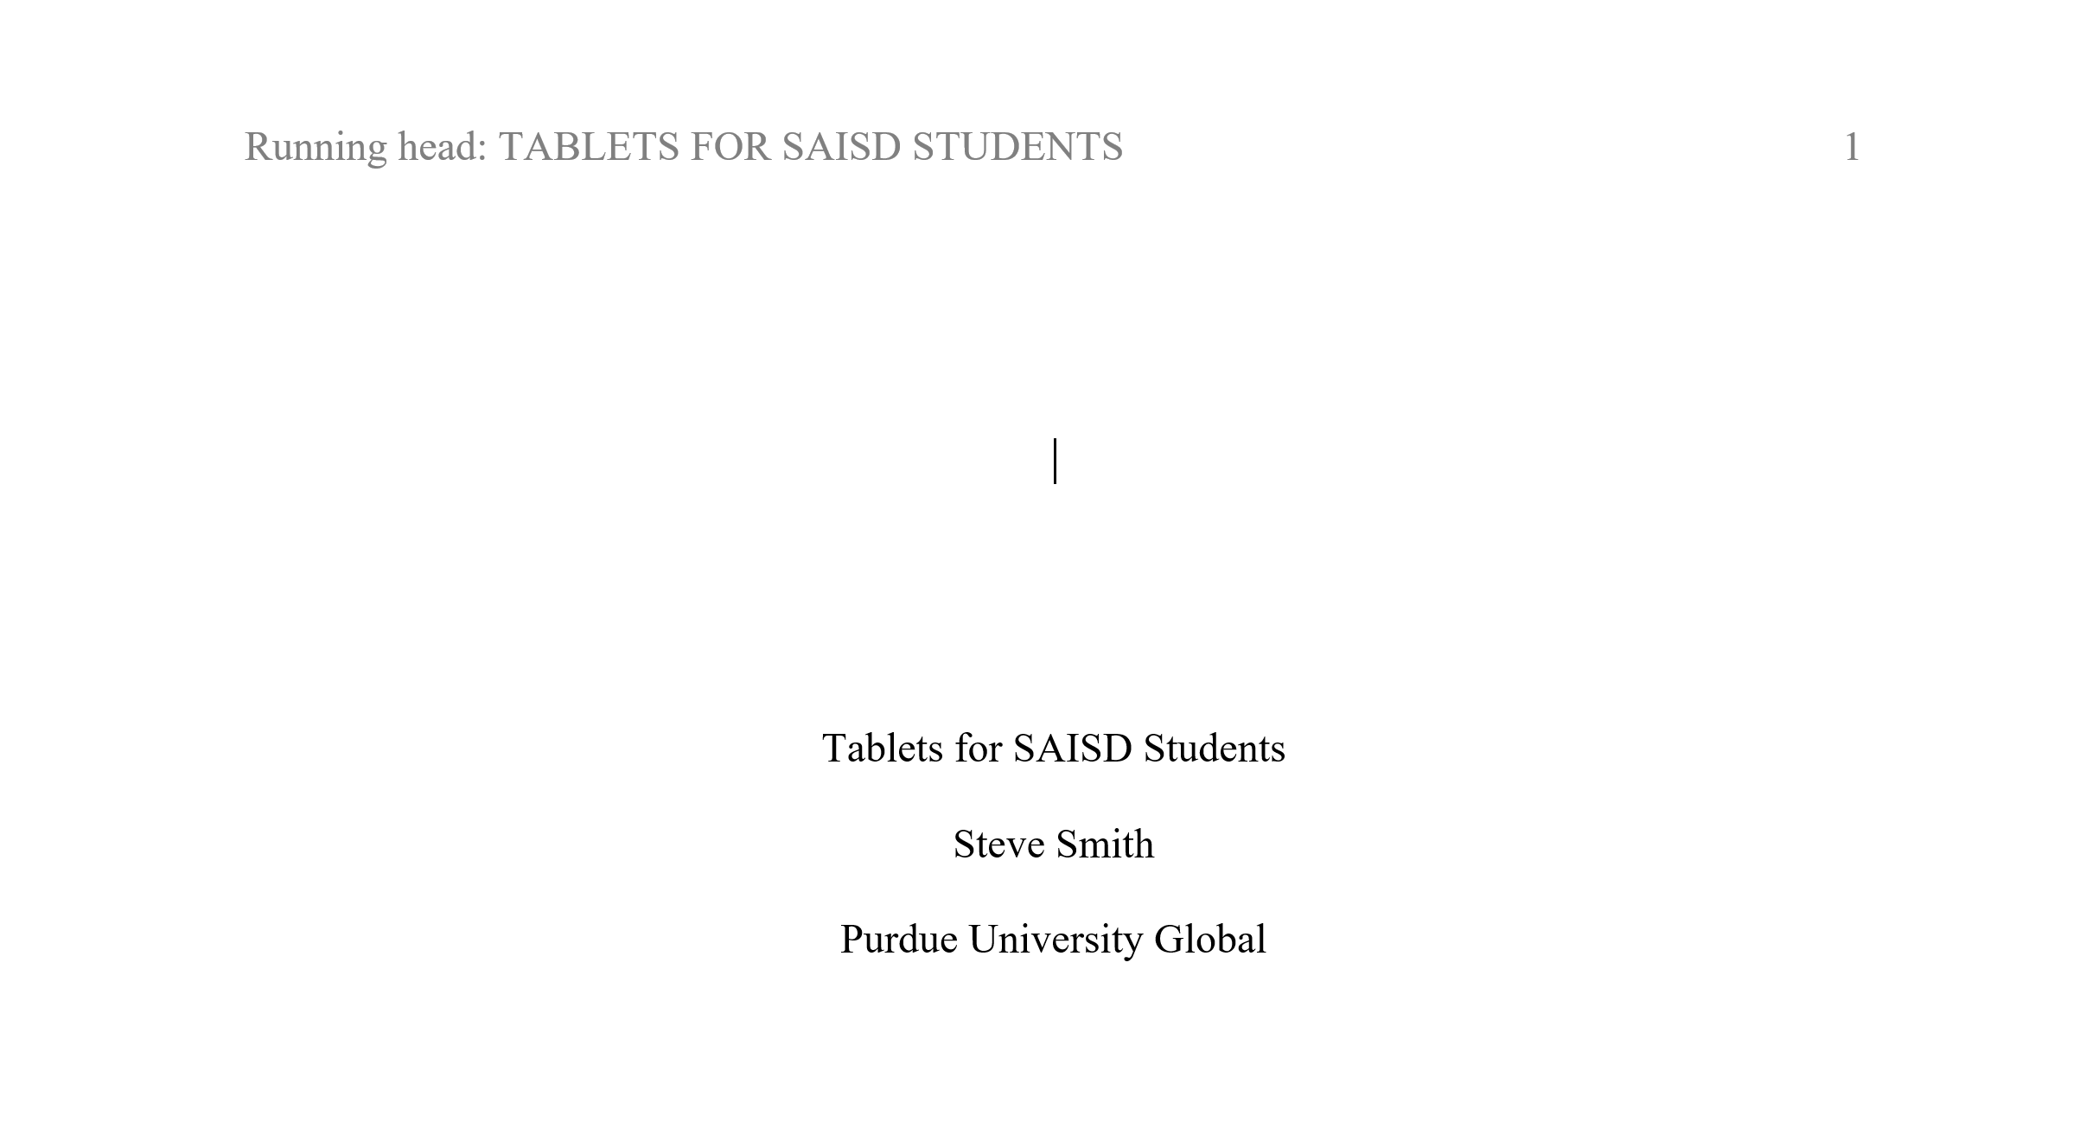

Slide 19
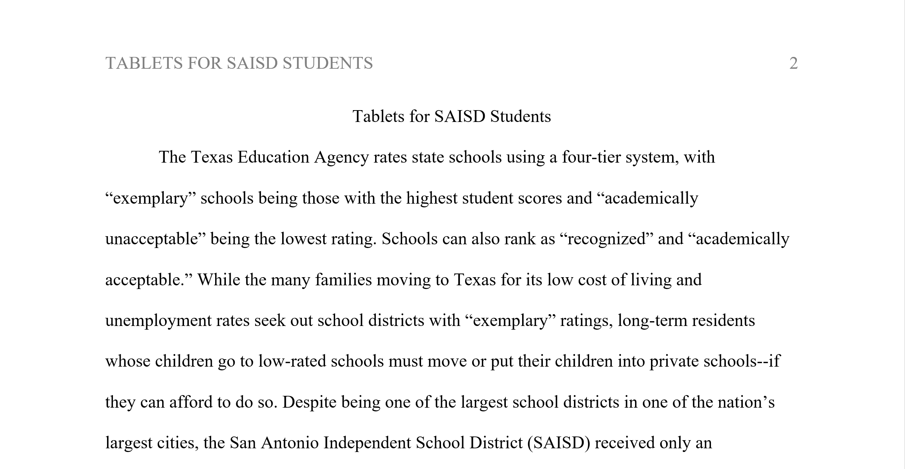

Slide 20
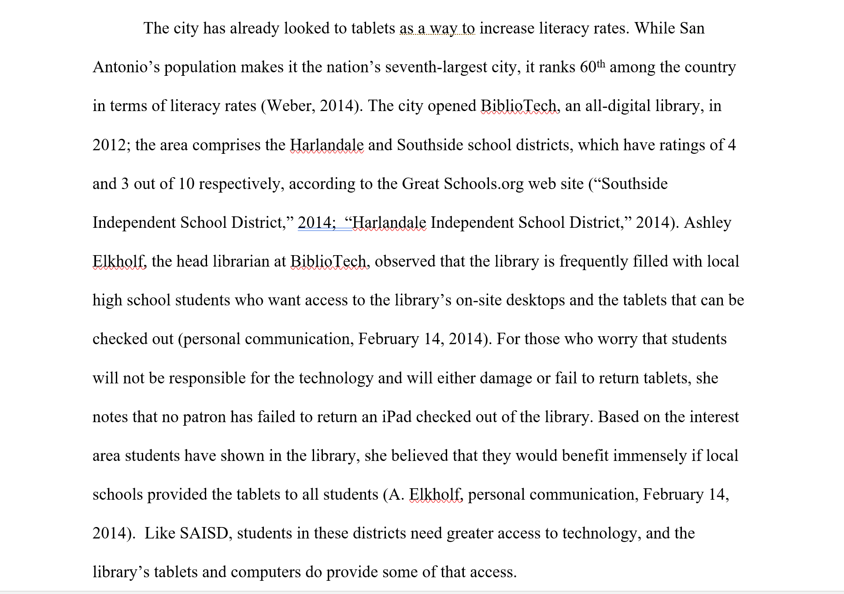
Body Paragraph

Slide 21
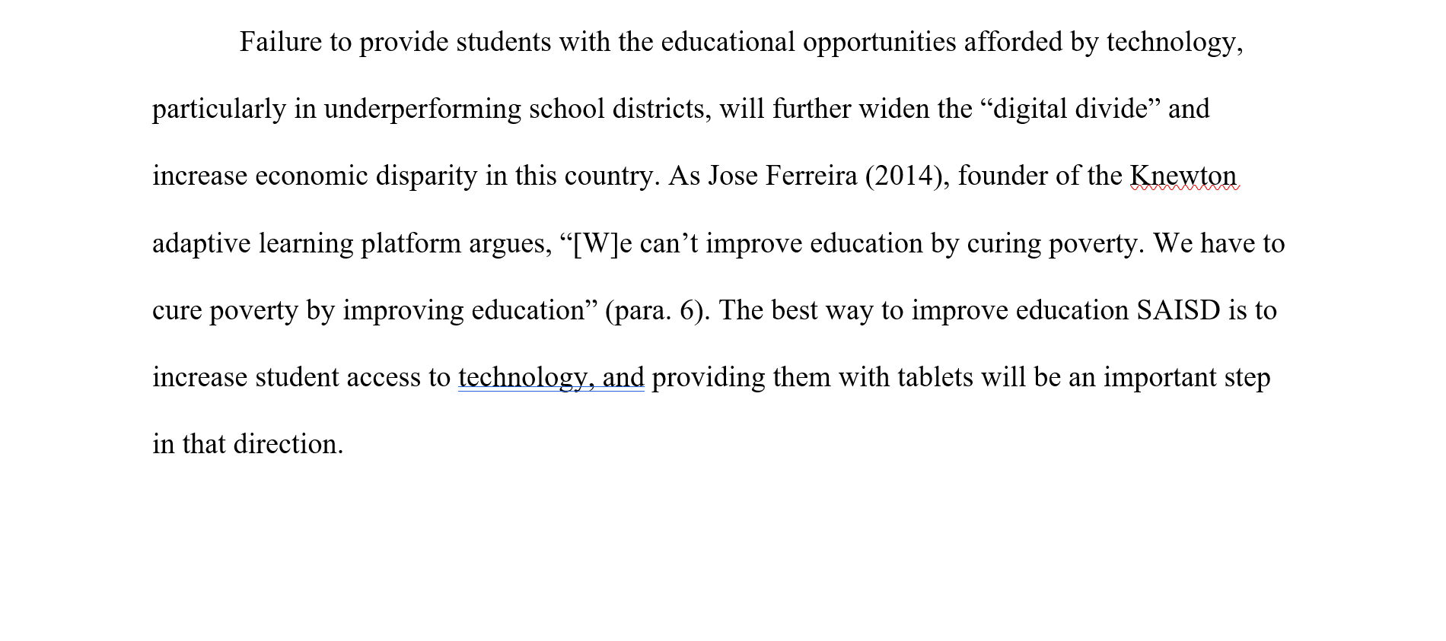
Conclusion

Slide 22
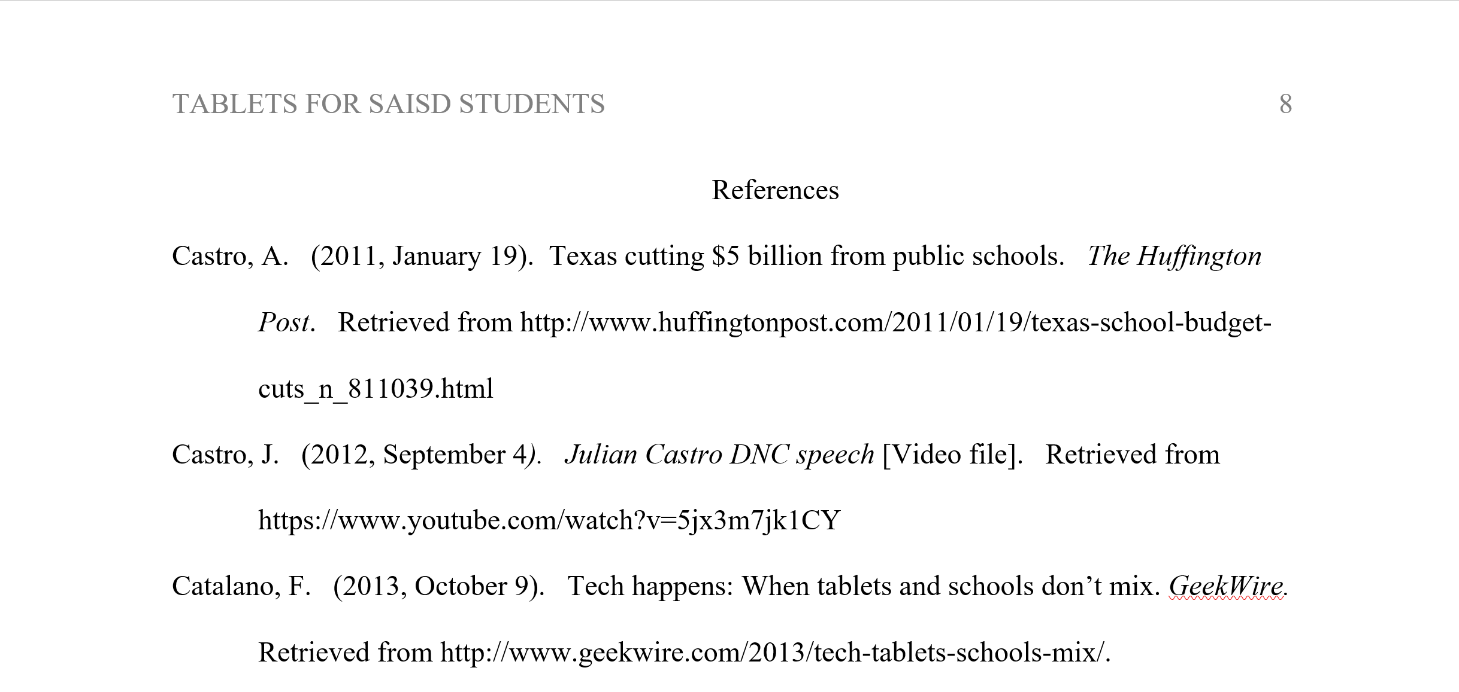

Slide 23
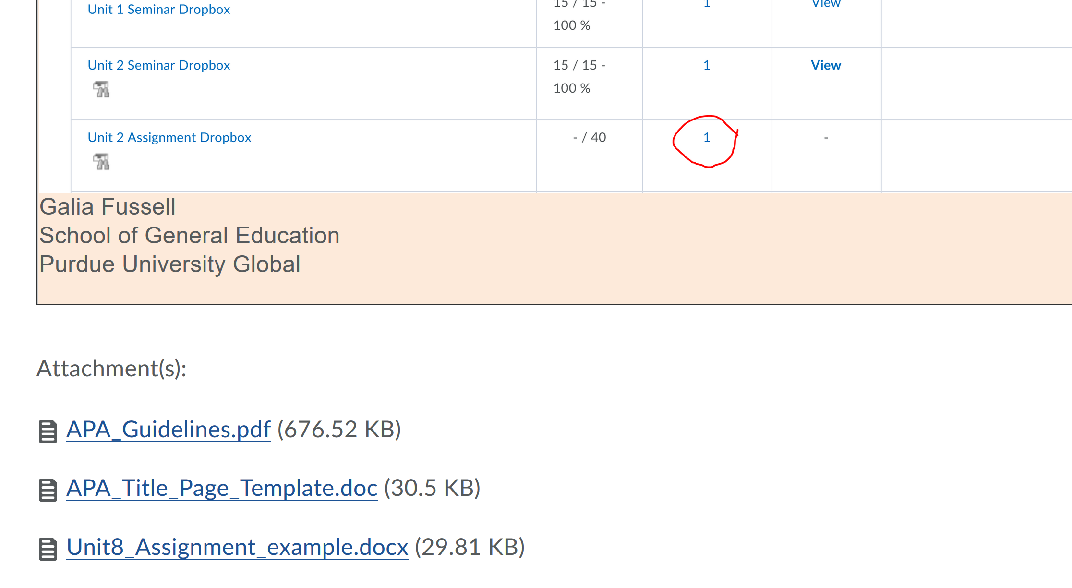
Where to Find a Sample Assignment?
Purdue University Global | This is Where the Title of the Presentation Will Go

Slide 24
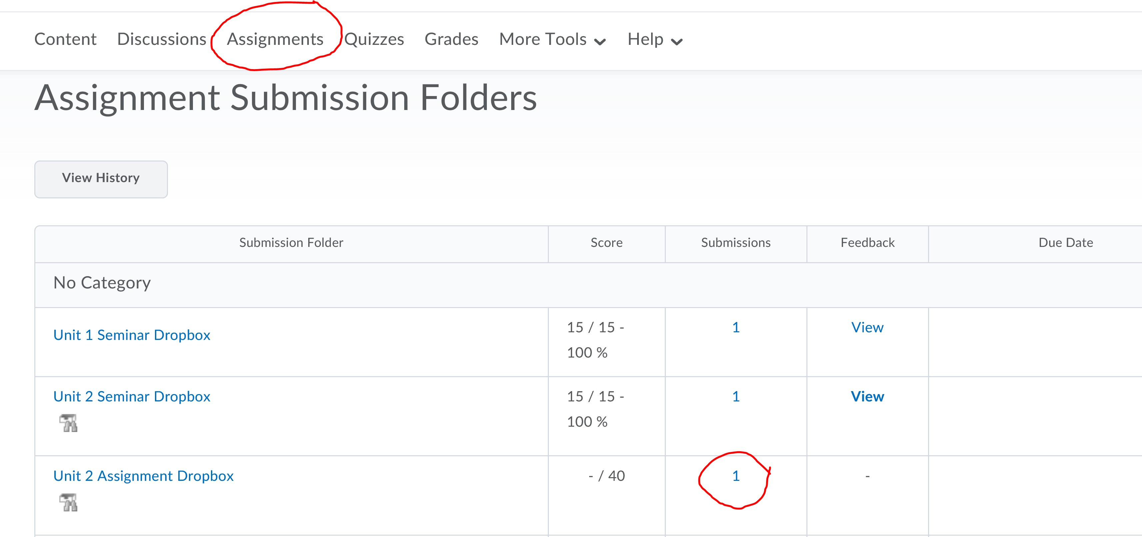
How to Find Turnitin Similarity Report?
Purdue University Global | This is Where the Title of the Presentation Will Go

Slide 25
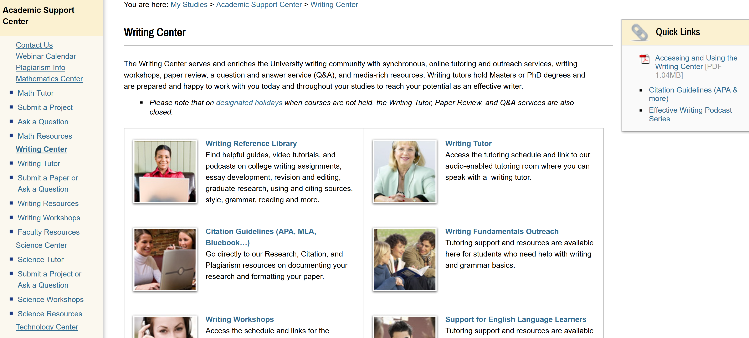
The Writing Center
Purdue University Global | This is Where the Title of the Presentation Will Go

Slide 26
Topics to Avoid
Abortion
Faith-based topics that rely on a person’s belief in a particular religion to accept the argument
Conspiracy theories and arguments that cannot be proven (alien abductions, demonic possession, etc.)
Teen pregnancy
Legalizing Marijuana
The Kennedy Assassination
UFOs
Who knew what pre-9/11
Secret Societies and One World or New World Order
Same sex marriage
Crop Circles
About politics
About religion
Assisted Suicide
Purdue University Global | This is Where the Title of the Presentation Will Go

Slide 27

Questions?

Slide 28
Unit 8
Introductions and Conclusions

Slide 29
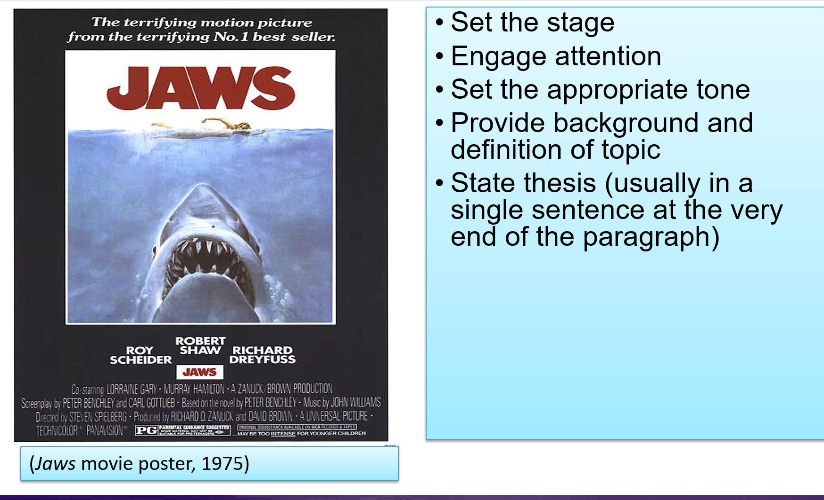
Introductions should. . .
Notes:
Jaws movie poster [Image]. (1975). Retrieved from http://www.movieposter.com/poster/MPW-18721/Jaws.html

Slide 30
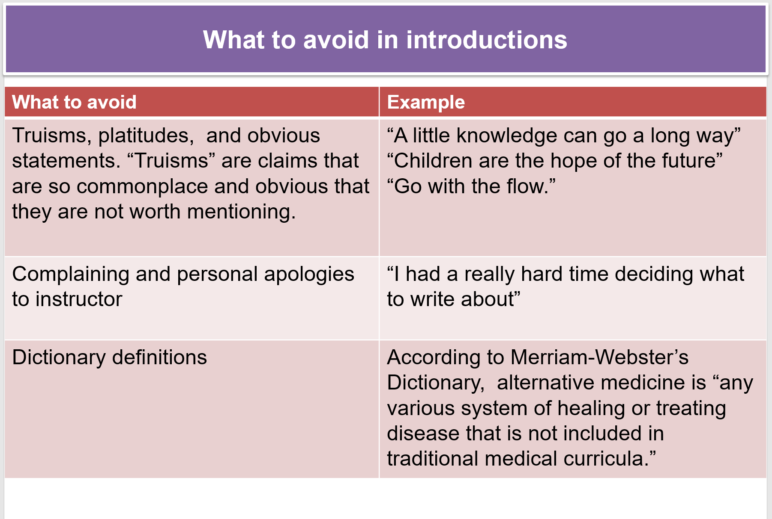

Slide 31
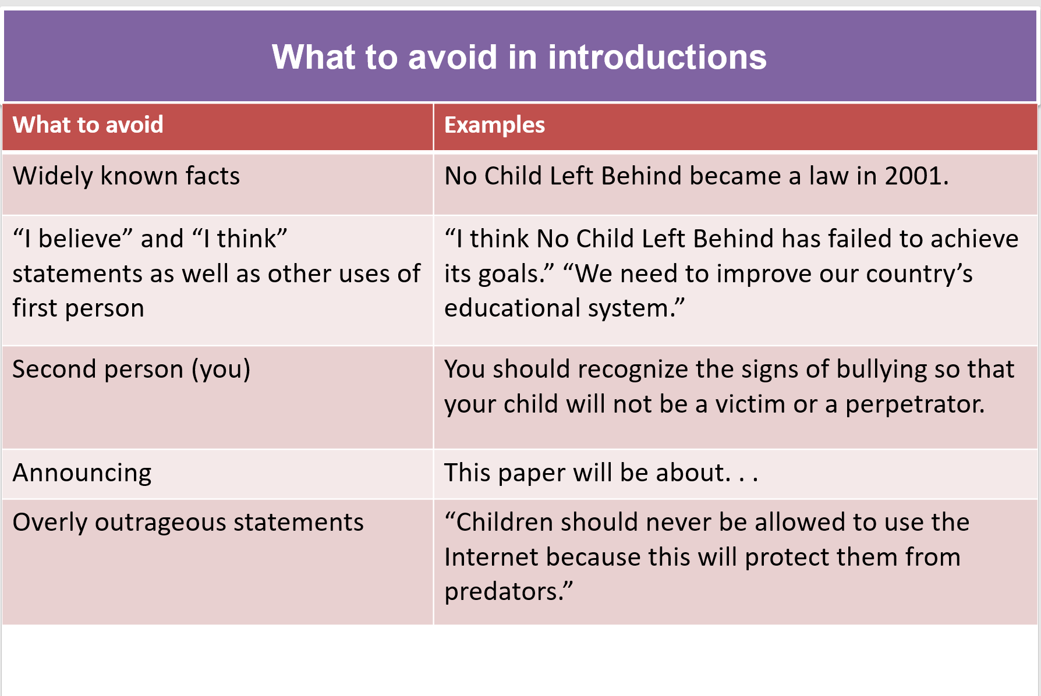

Slide 32

Some Strategies
Establish the issue
Pose questions
Use a narrative
Use an attention-getting statement
Use an extended example or series of examples
Define an essential term
Dramatize a scene
Use a quote
Use a shocking statement or statistic
(Clements, 2010, pp. 181-189)
See also “Writing a Good Introduction” in the Effective Writing Podcast Series.

Slide 33

Conclusions should . . .
Bring the essay to a logical close
Reinforce the main idea in an engaging manner (without just repeating the thesis and introduction)
Leave readers with something to think about

Slide 34
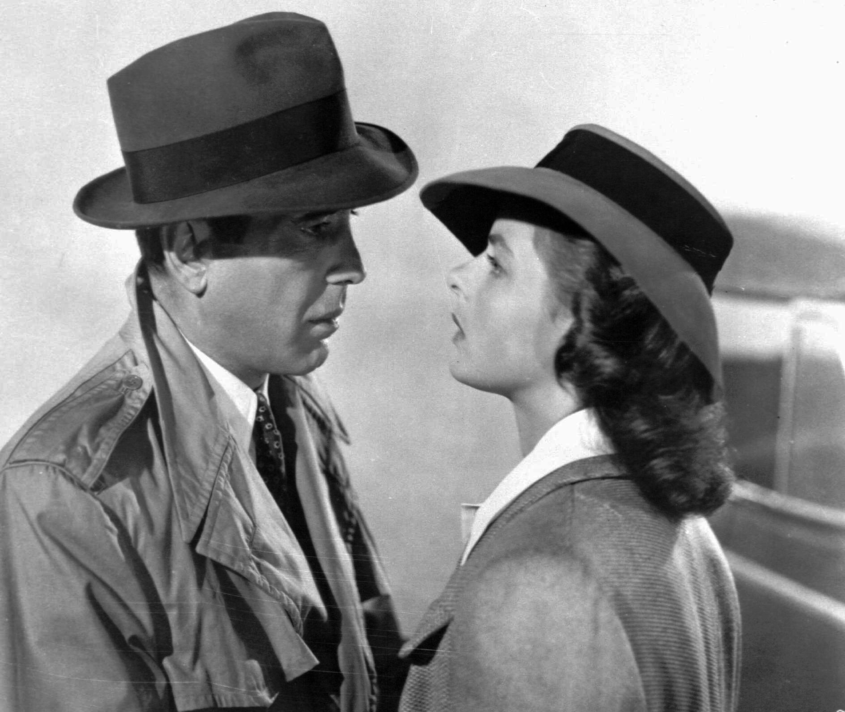
Best Closing Lines
“Louis, I think this is the beginning of a beautiful friendship.” (Casablanca, 1942)
“I’ll go home and I’ll think of some way to get him back. After all, tomorrow is another day!” (Gone with the Wind, 1939)
“Oh, Auntie Em, there’s no place like home!” (The Wizard of Oz, 1939)
What are your favorite closing lines or images in film, TV, and literature?
Casablanca [Image], 1942).
Notes:
Screenshot from Casablanca [Image]. (1942). Retrieved from http://dashandapinch.com/wp-content/uploads/2012/03/casablanca.jpg

Slide 35
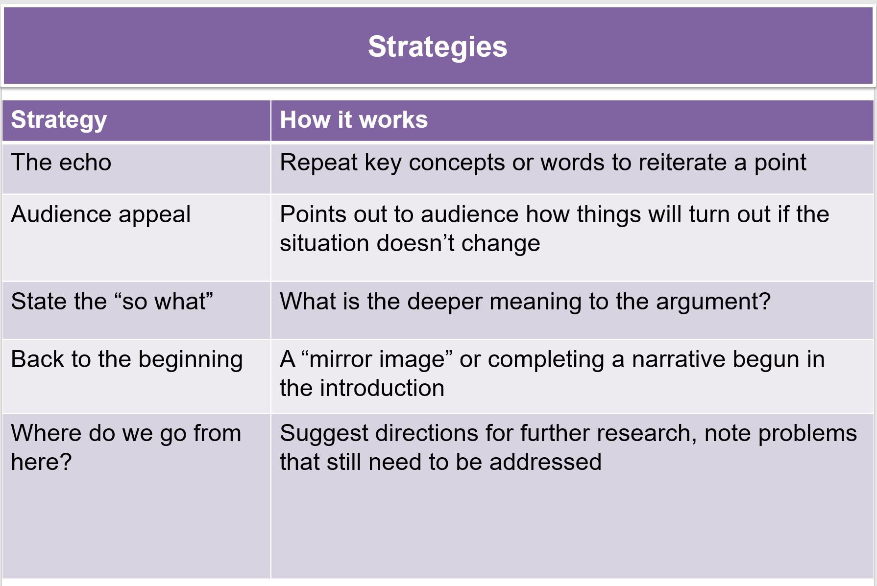

Slide 36

Any questions?

